Slide 1

HOSTEL MANAGEMENT SYSTEM
BY MEMBERS OF GROUP 7
1) SUBHADEEP MONDAL
2) SAYAN KUMAR PAUL
3) SOUGATA CHATTERJEE
4) SUBHANKAR BHOWMIK
5) IRFANA HUDA
6) MITHUN KUMAR MANDAL

Slide 2
CONTENTS
Introduction
Objective
Advantages
Application Workflow
Resources required
Project screenshots
Future scope of improvement
Acknowledgement

Slide 3
Introduction
“HOSTEL MANAGEMENT SYSTEM” is software developed for managing various activities in the hostel. For the past few years the number of educational institutions are increasing rapidly. Thereby the number of hostels are also increasing for the accommodation of the students studying in the institutions. And hence there is a lot of strain on the person who are running the hostel,and softwares are not usually used in this context.
This particular project deals with the problems on managing a hostel and avoids the problems which occur when carried manually. Identification of the drawbacks of the existing system leads to the designing of computerized system that will be compatible to the existing system with the system which is more user friendly and more GUI oriented. We can improve the efficiency of the system, thus overcoming the drawbacks of the existing system.

Slide 4
objective
Maintain the students as hostelites and waiting list students separately.
Process allotment list.
Automatically insert student’s details to the hostelite’s record when the allotment is confirmed by the admin and deleted when vacation is conformed or after the course end date.
Admin can view each student details.
Hostel secretary can calculate hostel fee including mess fee.
A record for supplier data can also be maintained.

Slide 5
advantages
Less human error.
Strength and strain of manual labour can be reduced
High security.
Data redundancy can be avoided to some extent.
Data consistency.
Easy to handle.
Easy data updating.
Easy record keeping.
Backup data can be easily generated.

Slide 6
Application workflow
The system allows user to register or login.One will be directed to the home page on successful login. On the menubar there are 4 menus- student, supplier, room and logout.On clicking on the new student button we are directed to the student detail form, followed by room allocation and payment page.By clicking on allocate room button we can access the booked room details & allocate rooms as per requirement.The application has also the scope for data entry of suppliers.

Slide 7
Resources required
Hardware Requirement :
Computer with:-
Processor : Intel Pentium
RAM : 256 MB RAM
Hard Disk : 2 GB

Slide 8
Resources required
Software requirement :
OS : 32 or 64 bit
JDK 1.8
Eclipse Mars 2
Language : JAVA

Slide 9
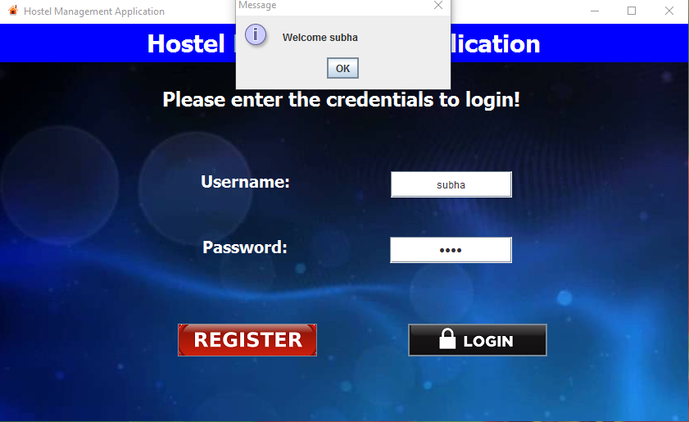
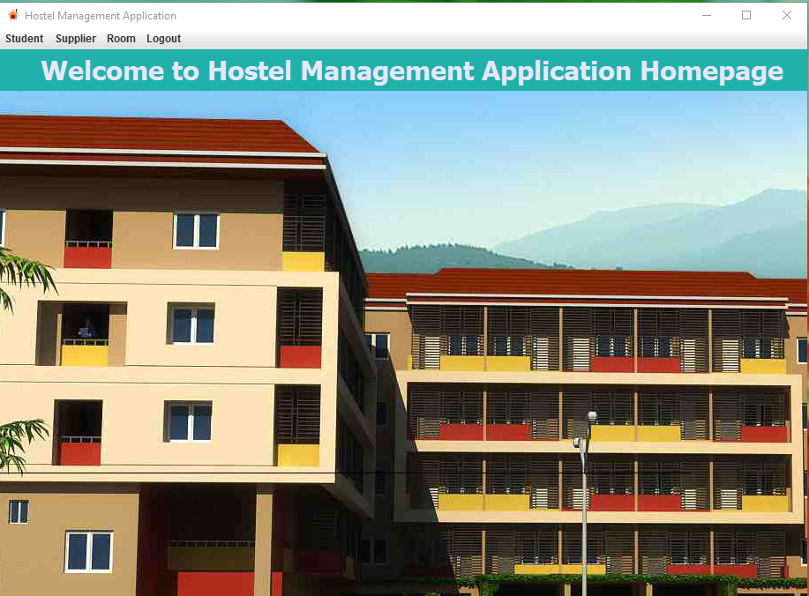
Login and homepage

Slide 10
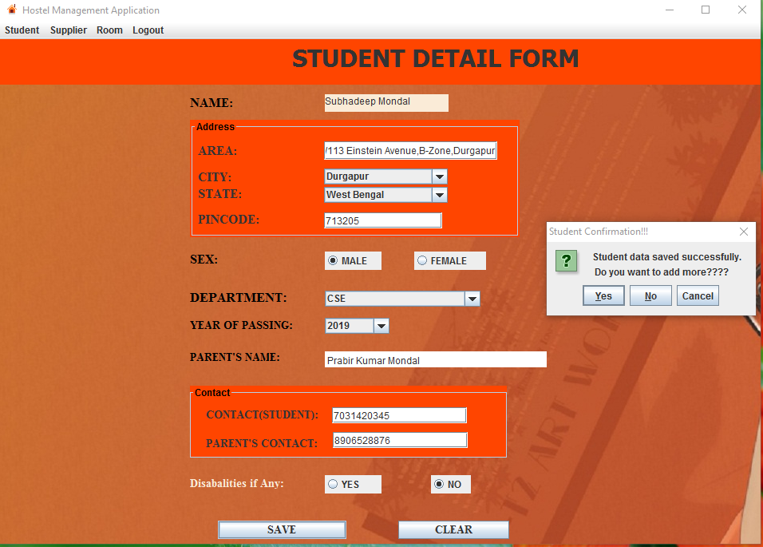
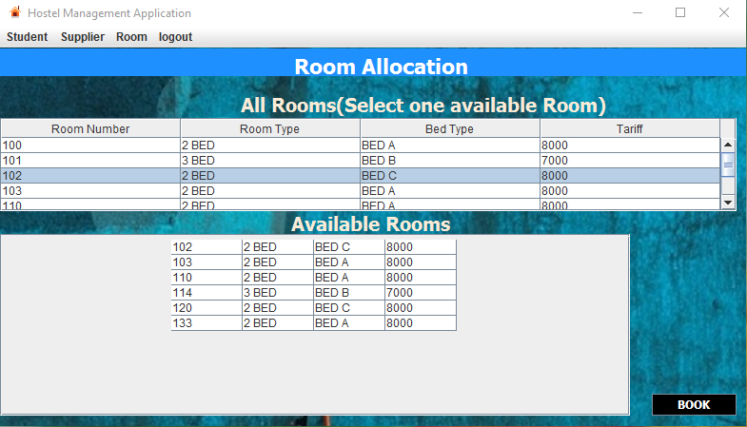
Student details and room allocation

Slide 11
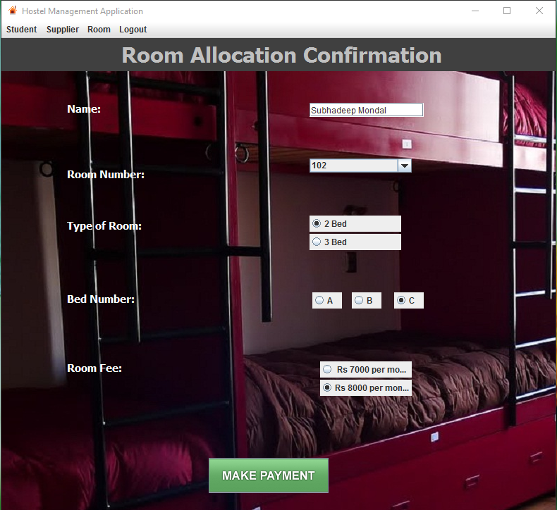
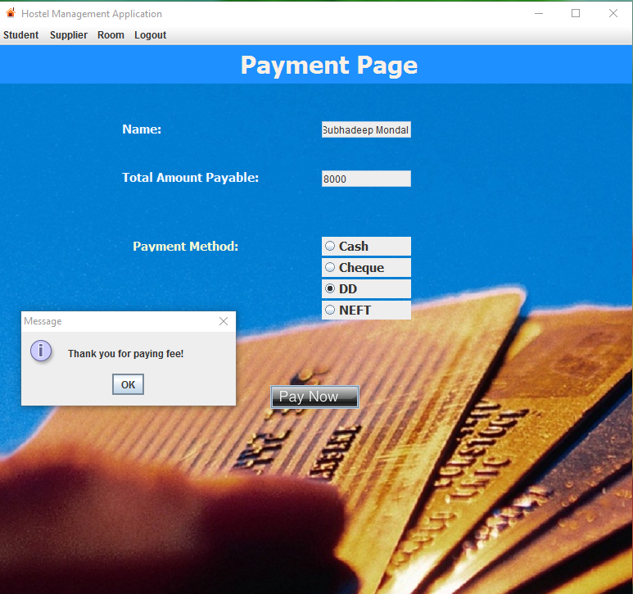
Room confirmation and PAYMENT PAGE

Slide 12
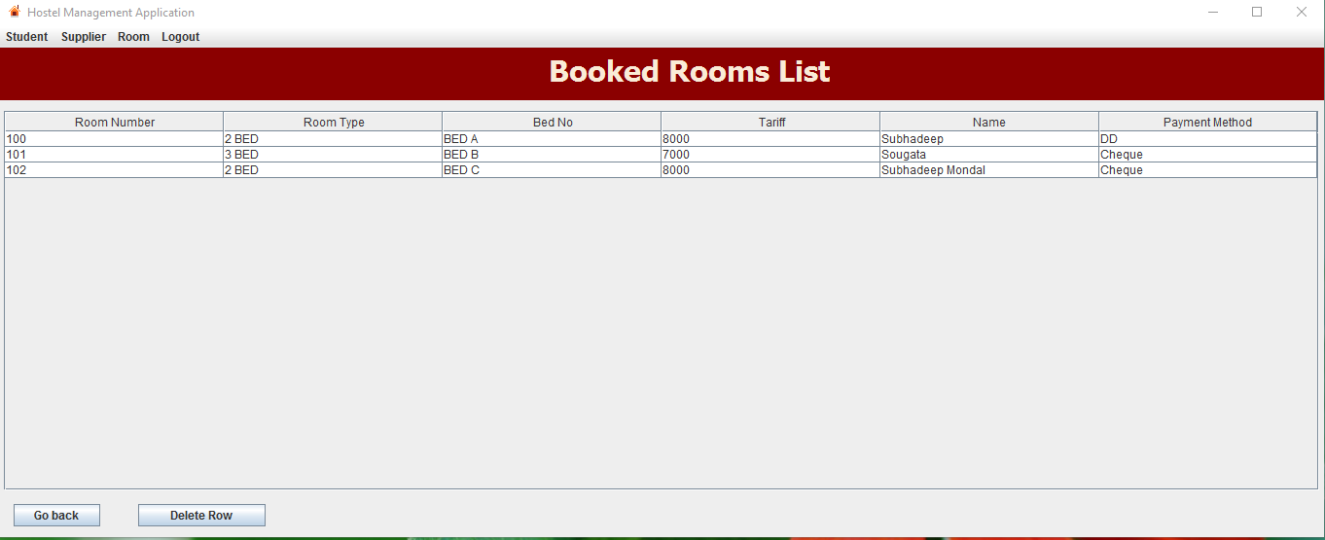
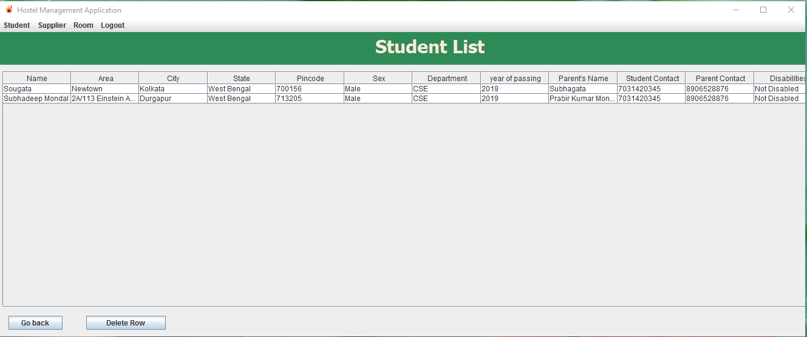
BOOKED ROOMS LIST and student list

Slide 13
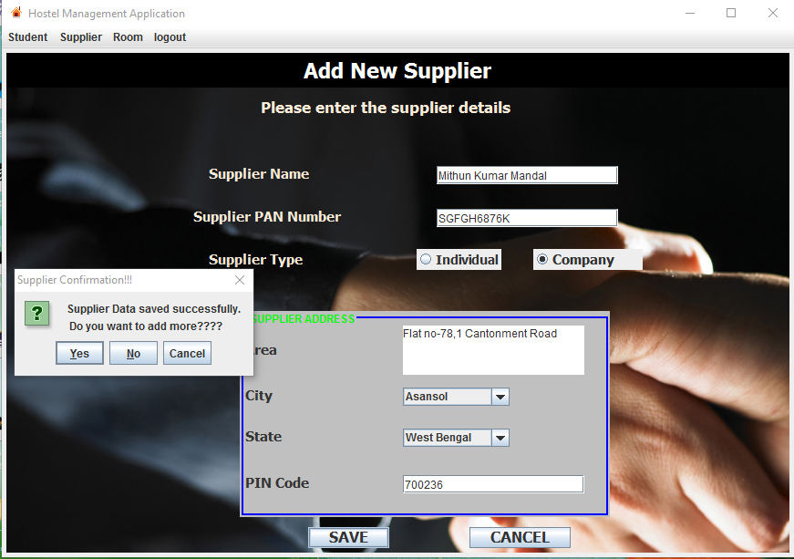
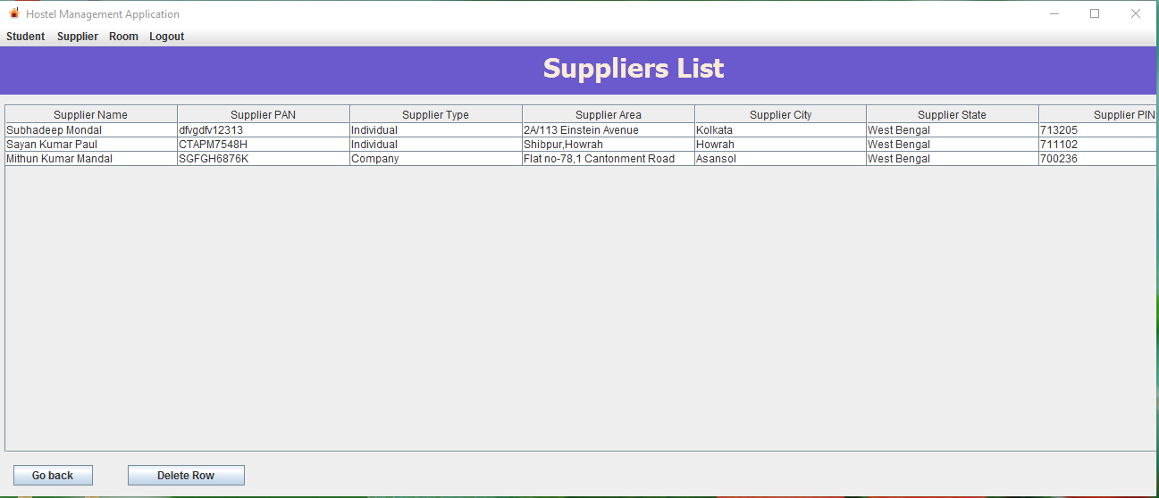
New supplier and supplier list

Slide 14
Future scope of improvement
1. Educational details of the students can be included.
2. Similar database can be created for library.
3. Complaint block can added to help the students.
4. SMS alert for student’s parents to make them aware of their child’s activities.

Slide 15
acknowledgement
We are most obliged and grateful to our guide at GLOBSYN official MR.DAYAMAY HALDER for giving us proper guidance in completing this project successfully. We are also grateful for right guidance and advice at the crucial junctures and for showing us the right way & helping us completing this project successfully. We are most obliged and grateful to our project guider for supporting and encouraging us throughout the course of study.
Finally we acknowledge with gratitude the unflagging support and patience of our team members for their guidance and encouragement during this dissertation work .
SUBHADEEP MONDAL
SAYAN KUMAR PAUL
SOUGATA CHATTERJEE
SUBHANKAR BHOWMIK
IRFANA HUDA
MITHUN KUMAR MANDAL

Slide 16


